Slide 1

Shark Attack
David, Ishwarya, Josean, Vanessa

Slide 2

Problem/Opportunity
A shark safety startup seeks government contracts with coastal towns.
they focus on safety through education, using shark cage diving experiences as an education tool
they want to know where and when to focus their initial efforts to maximize revenue with their limited starting budget
they have a limited amount of trained staff, which limits how many locations they can manage at once

Slide 3
Hypothesis
We hypothesize that the following 2 states and months will be the best places and times to focus their efforts on marketing to secure contracts and maximize revenue opportunities:
California, USA from May to September
New South Wales, Australia from Oct to April

Slide 4
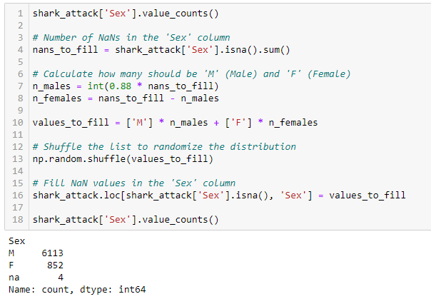
Project Overview
Our data cleaning process included:
Eliminating rows and columns of all null values and columns not relevant to our research
Standardizing categorical columns and converting dates to datetime
Cleaning strings by eliminating spaces, letters, punctuation etc.
Analyzing null values and filling null values as we deemed appropriate

Slide 5
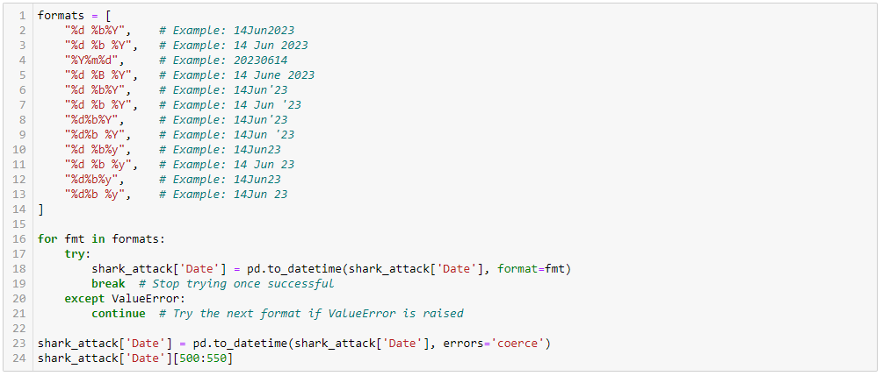
Data Wrangling and Cleaning
The most significant data cleaning challenge we faced was converting our dates to datetime type.

Slide 6
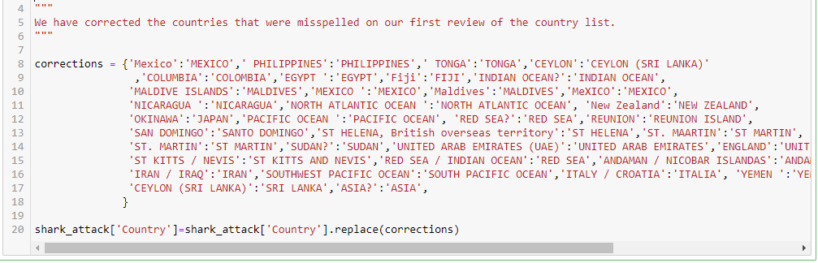
Data Wrangling and Cleaning
A secondary challenge was the large variety of misspellings across countries, states and locations that needed to be cleaned up.

Slide 7
Exploratory Data Analysis
The methods that we used were:
Summarize statistics
We filtered the data and created pivot tables to create comparison tables
Relationship between variables
We merged duplicates and dropped some rows with empty information
Visualization on graphics
Linear Graphic Chart
Bar Chart Graphic
Notes:
Summarize statistics
Relationship between variables
Visualization on graphics

Slide 8
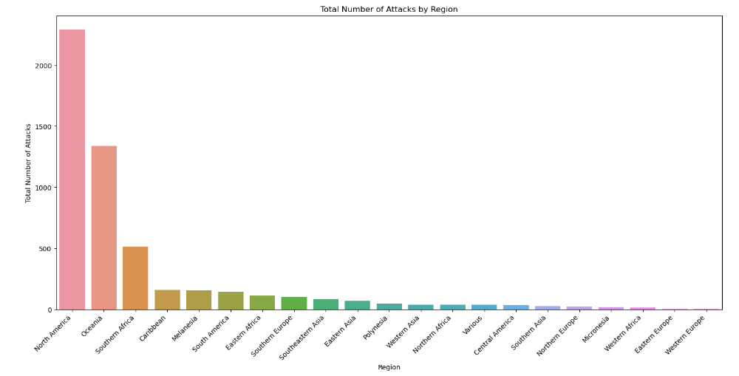
North America, Oceania and Southern Africa are our top regions for shark attacks. Our analysis will then focus on the top 2.

Slide 9
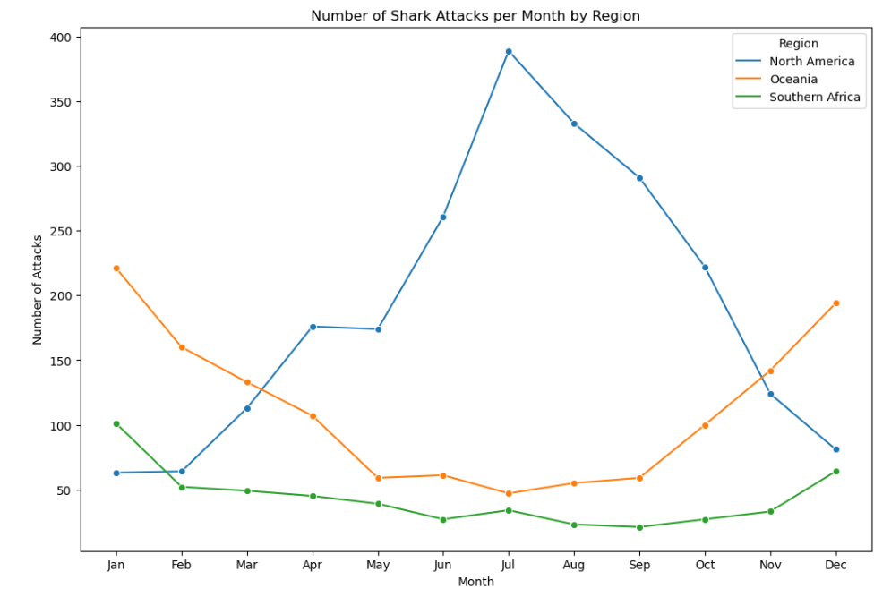
Summer time in North America: June to August
Summer time in Oceania: December to February
Summer time in Southern Africa: November to March

Slide 10
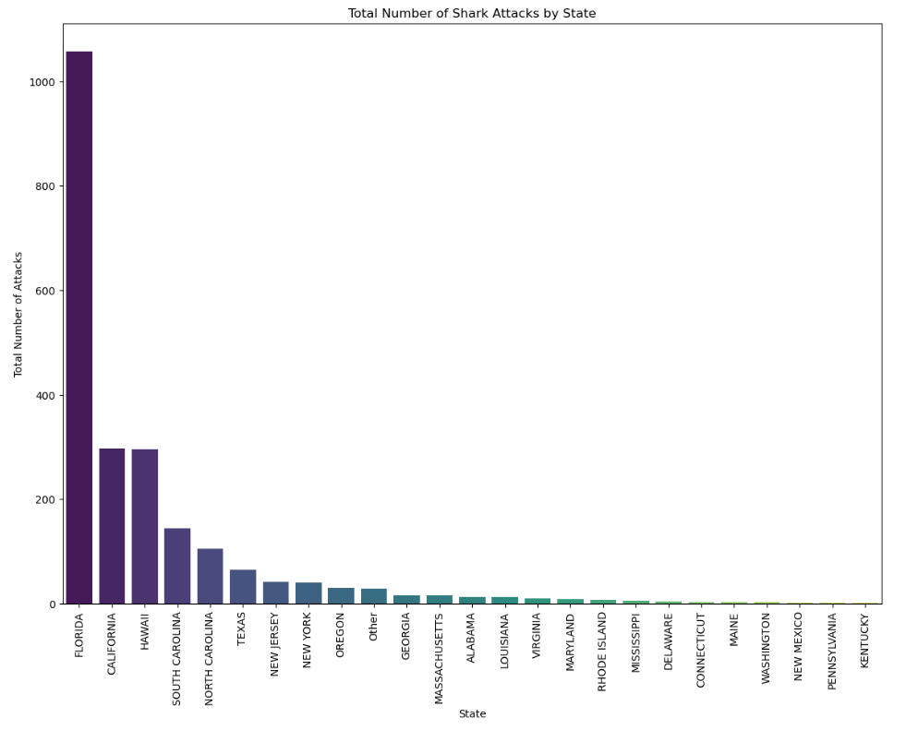
USA is the #1 region in North America.
Florida, California and Hawaii are the top 3 states, with Florida at #1 by a very high margin.

Slide 11
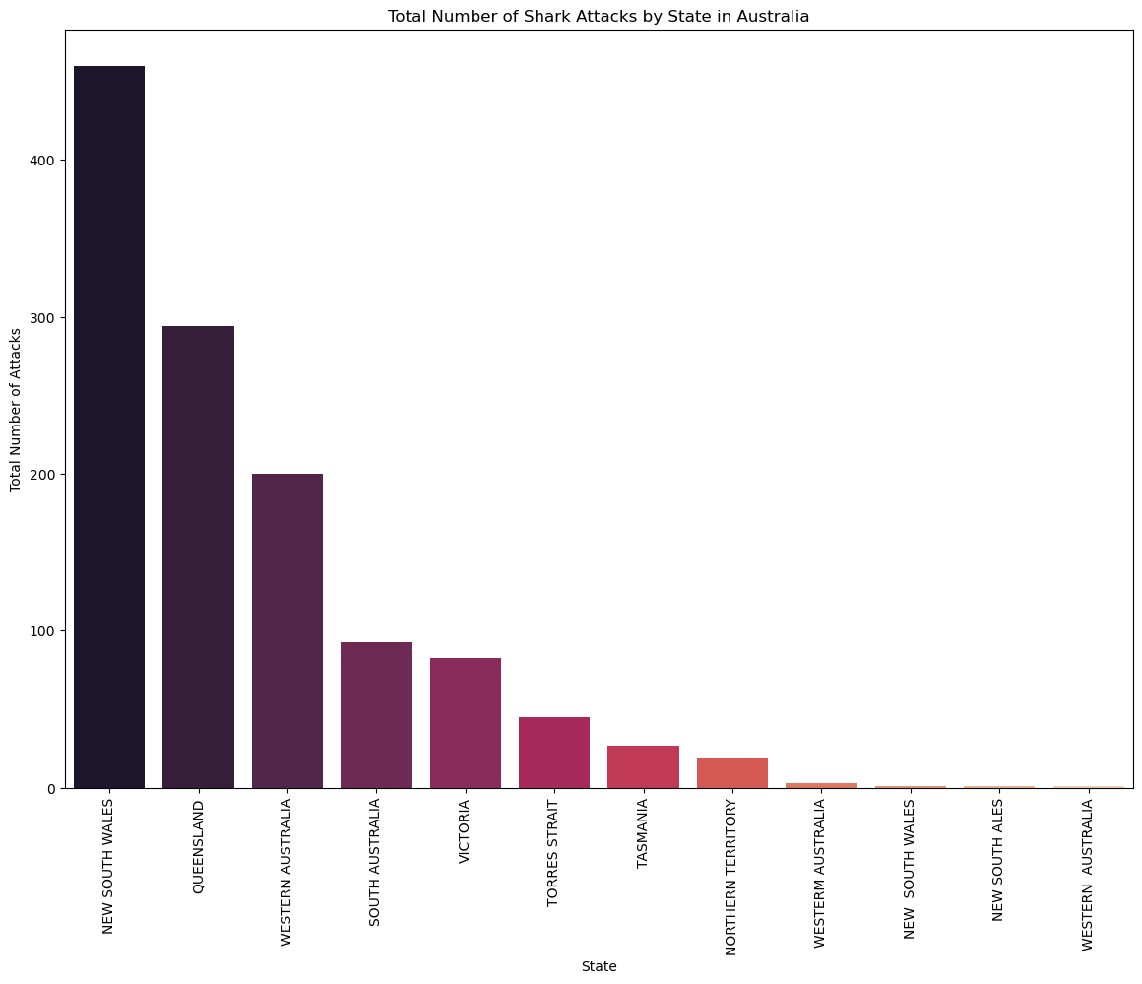
Australia is the #1 region in Oceania.
New South Wales, Queensland, and Western Australia are the top 3 states, with New South Wales at #1 by a very high margin.

Slide 12
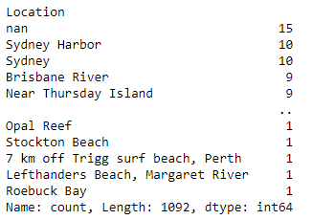
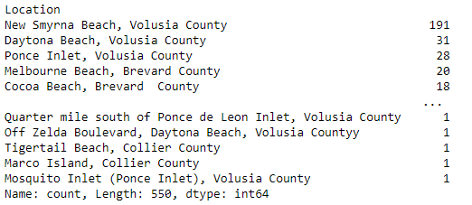
In Florida, New Smyrna Beach in Volusia County was the top location for shark attacks.
In New South Wales, Sydney was the top location for shark attacks.

Slide 13
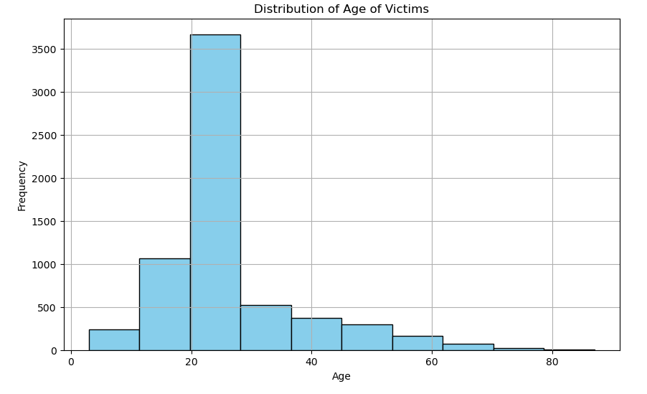
The vast majority of shark attack victims are in their 20s. This could be due to a variety of factors, such as they are more likely to engage in water-related activities, like surfing, swimming, and diving, which increase their likelihood of encountering sharks. Additionally, they might be more adventurous and willing to explore deeper waters where shark encounters are more common.

Slide 14
Conclusion and Insights
Our initial hypothesis: California, USA from May to September and New South Wales, Australia from Oct to April
The data shows: Florida,Volusia County June through September. Australia, New South Wales (where Sydney is)
We were surprised to see that the vast majority of victims were male, by a shocking margin.
While we didn’t expect it to be the top result, we were surprised the Caribbean did not have more reported incidents.
One major insight we discovered is that shark attack incident peaks lined up with the summer months of each region. This could be due to warmer waters during the summer months, which might attract certain shark species closer to shore, thereby increasing the likelihood of interactions with humans engaging in water activities

Slide 15
Implications of findings
Opportunity for lean operation: The company can optimize resources by not maintaining permanent bases in high-risk areas simultaneously. There can be flexibility in resource allocation based on seasonal fluctuations in shark attack frequency.
Customized educational materials: Further research can be done into the types of incidents to influence the educational materials sold by the company and the experiences they provide to their clients as well as their staff training.
Diversification of experiences: periods of lower risk of shark attacks can offer a wider range of water-based experiences. Alternative activities can be arranged during peak seasons, where there is higher susceptibility to shark encounters
Continuous Monitoring and Adaptation: Ongoing monitoring of shark activity trends is essential. Proactive adjustment of operations and risk management practices can be made based on evolving patterns.
Notes:
the company does not need permanent bases of operation in both places at once. Considering how the number of shark attacks flow means they can focus limited resources based on seasons.

Slide 16
Thank you!
David, Ishwarya, Josean, Vanessa

